Slide 1

Numele echipei:
0xcHa0s
Memberii:
Podean Roxana-Andreea
Ploscaru Carla
Pop Adrian
Pop Alexandru
Plăvăț Vlad
Pop Tudor-Antoniu

Slide 2
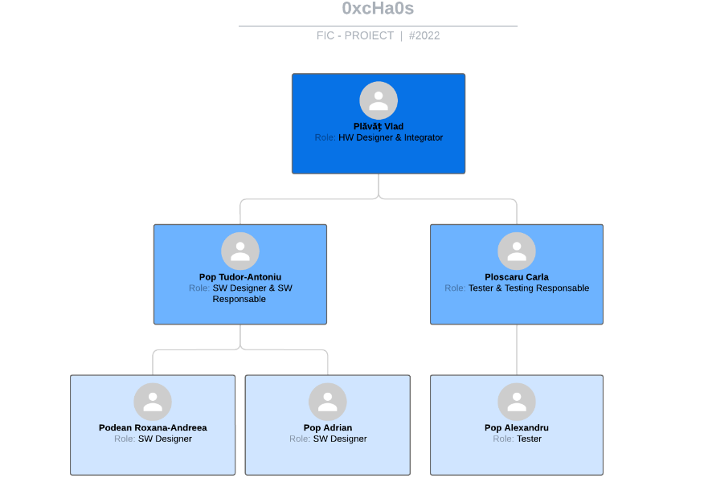

Slide 3

Tema aleasa de echipa:
Calculator de buzunar

Slide 4
`
Bibliografie:
https://www.sciencedirect.com/topics/computer-science/general-purpose-processor
https://en.wikibooks.org/wiki/Embedded_Control_Systems_Design/Processors
https://www.fpga4student.com/2017/04/verilog-code-for-16-bit-risc-processor.html
https://en.wikipedia.org/wiki/History_of_general-purpose_CPUs

Slide 5
`
Vă mulțumim!
https://github.com/ptudorr/0xcHa0s

